Slide 1
LinkedIn Students
Job Search App for Students and Fresh Graduates
Product Owner: Aysenur Albayrak

Slide 2
Background
Why Are We Here?
To help students and fresh graduates during the job searching, we will build a job searching application that provides easy access to entry level jobs and internships at some of the best companies worldwide.
LinkedIn Students
© 2019 Udacity. All rights reserved.

Slide 3
Business Case
© 2019 Udacity. All rights reserved.

Slide 4
Initial Focus
Where are we starting?
Linkedin currently used for;
Professional networking
Employers posting jobs
Job seekers posting their CVs
EXPANDING THE JOB MARKET OFFERINGS
© 2019 Udacity. All rights reserved.

Slide 5

Opportunity
What’s the problem?
According to the job site Glassdoor, postings in May 2020 calling for entry-level job seekers were down 68% compared to the year prior.
The overall unemployment rate was 11.1% in June — that number jumps to 19.8% for those aged 20-24, according to the Bureau of Labor Statistics.
© 2019 Udacity. All rights reserved.

Slide 6
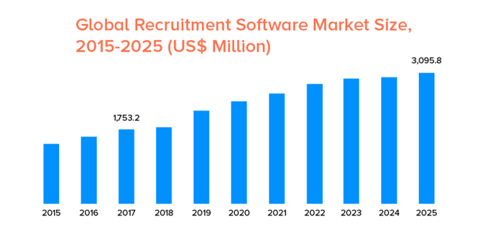
Opportunity
What’s the problem?
8% of companies were planning to or had already revoked job offers to class of 2020 graduates.
*according to a June poll from the National Association of Colleges and Employers
This statistic shows the Global Recruitment Software Market Size from 2015 and expected value of 2025 (US$ Million)
*Source
© 2019 Udacity. All rights reserved.

Slide 7
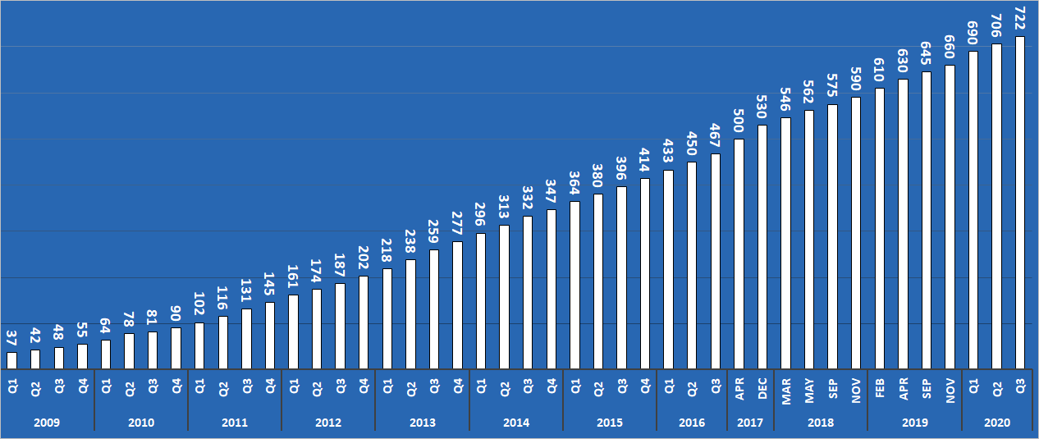
Opportunity
What’s the problem?
Linkedin has 174M total users in US and %28 of them is aged 18-29 → 48M
We will assume %50 of them is recent graduate → 24M users (*)
Total revenue per user → 11,08$
Linkedin User growth, 2009-2020, millions(*)
Total Addressable Market = Number of Target User x Revenue per user
= 24M x 11.08$
=$283M
© 2019 Udacity. All rights reserved.

Slide 8

Proposal
What’s Our Solution?
A job application for specifically for students and fresh graduates:
Job recommendation
Networking
Company and job search
Worldwide opportunities
Partnership with companies and colleges
© 2019 Udacity. All rights reserved.

Slide 9

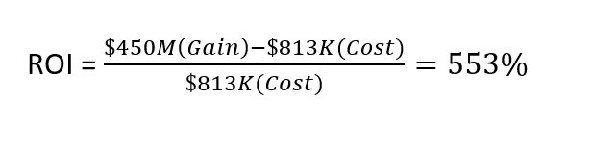
Return On Investment
What can we do?
COST of(*)
Developers: $120K/year x 5
Business analyst:$70K/year
Test engineer:$83K/year
UI/UX Designer:$50K/year
Avg. marketing: $10K
Platform:$125
Indeed currently generates $3B a year from 3B unique users(*). If %30 of the users are students and at the beginning we can draw %50 of that user, that would represent $450M a year in revenue.
© 2019 Udacity. All rights reserved.

Slide 10
Measurement
How will we know if we’re successful?
Number of Total Clients, Jobs & Applicants
percentage of job seekers who are invited to apply to jobs
Average Applicants per Job
Total Revenue and Profit
© 2019 Udacity. All rights reserved.

Slide 11
Competitors
© 2019 Udacity. All rights reserved.
Notes:
[ALL PARTICIPATION]

Slide 12

Founded in 2004
250 million monthly users with 10 new job listings added per second(*).
Full description of the job posting on the preview page
How company is rated by employees
Estimated annual revenue $3B(*)
© 2019 Udacity. All rights reserved.

Slide 13

Founded in 1995
Provide direct access to internships and entry level jobs for students and fresh graduates
#1 entry level job site for recent alumni
*according to Alexa rankings
Estimated annual revenue is $7M(*)
Operates in:
USA, Australia, Canada, Hong Kong, India, Ireland, New Zealand, Nigeria, Philippines, Singapore, South Africa, UK
© 2019 Udacity. All rights reserved.

Slide 14
Our Advantages
Why are we better?
Linkedin is the leading job search service in the world and has a large customer base.
The app specialized for the students.
User friendly UI&UX
Partnership with the companies
Attractive contents for students
© 2019 Udacity. All rights reserved.

Slide 15
Roadmap and Vision
© 2019 Udacity. All rights reserved.
Notes:
[ALL PARTICIPATION]

Slide 16

Roadmap Pillars
Where do we go from here?
Our vision is expanding global job market offerings of LinkedIn with helping soon-to-be graduates in hunting for their first job out of college.
© 2019 Udacity. All rights reserved.

Slide 17
Effective Profile Management for Users
Sign Up/Login
Job Search + Filter for applicants
Job post, edit for recruiters
Resume filter for recruiters
Management functions for admins
© 2019 Udacity. All rights reserved.

Slide 18
Increasing User Engagement
Job recommendation alerts
Job save
For recruiters, send job invite
Resume download
© 2019 Udacity. All rights reserved.

Slide 19
Successful Integrations
Content Management System
Payment integrations
Real-time analytics tools
© 2019 Udacity. All rights reserved.

Slide 20
Partnerships
Universities
Top Companies
Public Service Organizations
© 2019 Udacity. All rights reserved.

Slide 21
Where do we go from here?
Widening the scope
Offer an in-app communication facility like messaging or voice/video call.
Document scanner.
Increasing the app rate on stores.
© 2019 Udacity. All rights reserved.

Slide 22
Thank You

